Slide 1
Day 5
Amazon Web Services, Unix, Containers

Slide 2
Topics
Unix
Architecture
Commands
Environment Variable
File Permissions
Package Managers
AWS Introduction
Regions and Availability Zone
EC2
SSH to ec2
SecurityGroup
AMI
EBS

Slide 3
Unix
Operating System

Slide 4
Operating System
To control and manage computer hardware, software resources, and Operating system is required for the computer. The operating system acts as the intermediate between hardware and the user-defined application software.

Slide 5
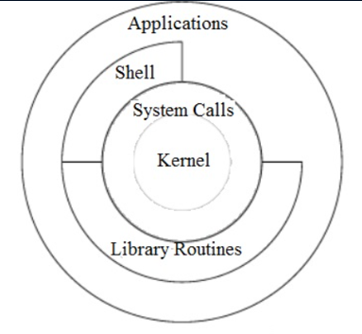
Unix Architecture
Kernal
Computer hardware such as memory, disc, printers, etc.. are controlled by the kernel.
The kernel schedules the processes, control and executes various user-defined tasks.
Manages the data storage and control the computer accesses by several users.
The kernel is composed of several sub-components such as configurations including boot code, device drivers to control hardware, header files.
Shell
It is the interface between the user and the kernel.
Users can interact with the shell using shell commands.
Shell has two main responsibilities which include interpreting the commands given by the users and execute them using the kernel, providing programming ability to the users to write shell commands for a shell script to perform specific tasks.
Eg: Bourne shell , Bash, C

Slide 6
Unix Architecture
System Calls:
A system call is a way for programs to interact with the operating system. A computer program makes a system call when it makes a request to the operating system’s kernel.
System call provides the services of the operating system to the user programs via Application Program Interface(API)
FileManagement/ Device Management

Slide 7
Unix File System
Unix File System can be defined as a framework that organizes and stores a huge volume of data that can be handled with ease. It involves elements like file which is a collection of related data that can be viewed logically, appears as a stream of bytes, with attributes containing information in relation to the concerned file.
The file system consisting of two main
files
Directories
The entire system following a hierarchy in which directories act as special files that contain multiple files with the highest-level directory in the entire hierarchical structure being termed as root which is symbolically denoted by ‘/’. There can be many subdirectories under this directory.

Slide 8
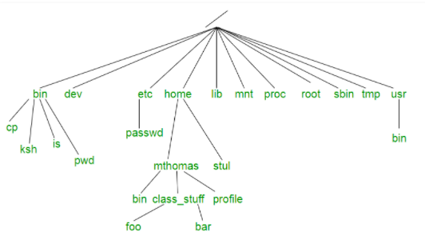
Unix FileSystem
bin: It is a short form for binary files. This directory stores the commonly used executable commands.
mnt: This contains information regarding the mounted devices.
root: This is the root user’s home directory.
tmp: This is a storage for temporary files. As they are temporary they are removed periodically from the filesystem.
usr: It contains a set of executable commands
home: It has a collection of directories and files.
proc: It contains files that are related to system processes.

Slide 9
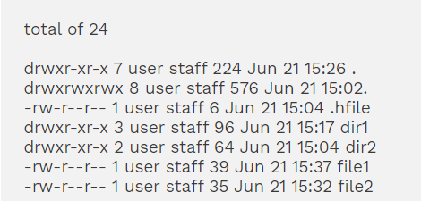
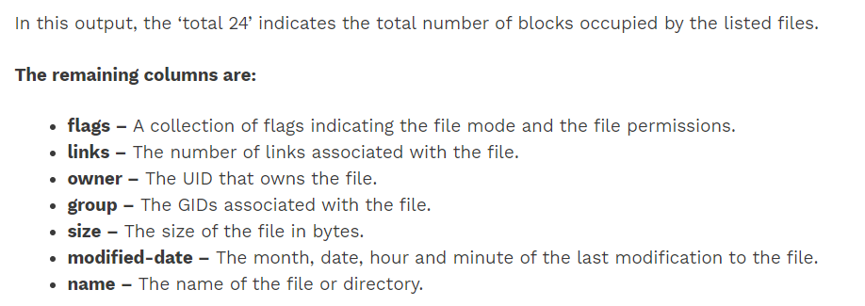
File Permssion

Slide 10
Lab: FilePermission
chmod u+x student.txt
chmod u-x student.txt
$ chmod 777 file1
$ ls –l
https://en.wikipedia.org/wiki/Chmod

Slide 11
Types of File System
1. Ordinary Files
These files are used to store information of the users. It may be some text or any image which is stored. It is normally located under a directory and does not contain any other files.
2. Directories
Directories help in organizing the files which are present. The directories can contain ordinary files, special files or even other directories. All these directories are the descendants of the root directory.
3. Special Files
The special files are used to represent physical devices like printer, tape driver or a terminal. Unix considers any device to be a file. Even the terminal is considered to be a file.

Slide 12
Unix
Pwd
Present working directory
Cd /
Switch to root /
Cd ~
Switch to home directory
Cd /home
Switch to home folder in
Cd ..
Switch to a folder back in file structure.
Mkdir <fodlername>
Create a folder
Touch student.txt
Create an empty filer
Date
Display current date
Cal
Ps
Whoami - Print current login user.
Who - List all login users.
Ps
echo "$SHELL"

Slide 13
Unix Commands
Three types of files
Ordinary File
Directeries
Special files
Commands
Ls
Ls –l
First Column − Represents the file type and the permission given on the file. Below is the description of all type of files.
Second Column − Represents the number of memory blocks taken by the file or directory.
Third Column − Represents the owner of the file. This is the Unix user who created this file.
Fourth Column − Represents the group of the owner. Every Unix user will have an associated group.
Fifth Column − Represents the file size in bytes.
Sixth Column − Represents the date and the time when this file was created or modified for the last time.
Seventh Column − Represents the file or the directory name.
find "a.txt"
ls -l | grep "student“
Env
$ ps // Print processes of current user
$ ps -e // Print all processes
$ ps -ef // Print all processes in full-listing

Slide 14
Cut Command
The cut command extracts a given number of characters or columns from a file. For cutting a certain number of columns it is important to specify the delimiter. A delimiter specifies how the columns are separated in a text file
Lab :Create a file emp.txt
$ echo "Employee_id;Employee_name;Department_name;Salary
10001;Employee1;Electrical;20000
10002; Employee2; Mechanical;30000
10003;Employee3;Electrical;25000
10004; Employee4; Civil;40000" > emp.txt

Slide 15
Cut Command
Extract 5 column
$ cut -c 5 data.txt
Extract
$ cut -c 5-7 emp.txt

Slide 16
Head
Display top 2 lines in emp.txt file
head -n 2 emp.txt
Prints the first ‘num’ bytes from the file specified. Newline count as a single character, so if head prints out a newline, it will count it as a byte. num is mandatory to be specified in command otherwise displays an error.
head -c 10 emp.txt

Slide 17
TAIL
Display bottom 2 lines in emp.txt file
tail -n 2 emp.txt
Prints the first ‘num’ bytes from the file specified. Newline count as a single character, so if head prints out a newline, it will count it as a byte. num is mandatory to be specified in command otherwise displays an error.
Tail -c 10 emp.txt

Slide 18
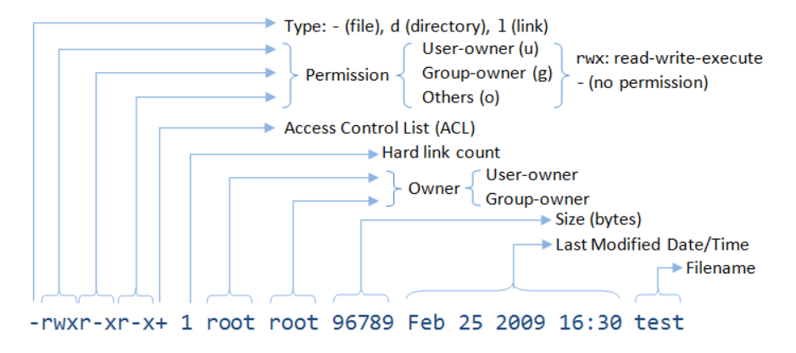
Unix – File Permission
Owner permissions − The owner's permissions determine what actions the owner of the file can perform on the file.
Group permissions − The group's permissions determine what actions a user, who is a member of the group that a file belongs to, can perform on the file.
Other (world) permissions − The permissions for others indicate what action all other users can perform on the file. Owner permissions − The owner's permissions determine what actions the owner of the file can perform on the file.
Group permissions − The group's permissions determine what actions a user, who is a member of the group that a file belongs to, can perform on the file.

Slide 19
Special System's Environment Variables
HOME: contains your home directory.
PATH: contains the list of search paths for executing programs (defined in /etc/profile).
PWD: Full path of current working directory (OLDPWD for the previous working directory).
USER: Current login username.
SHELL: Current shell, e.g., /bin/bash
Set Path Permanently
export PATH=~/bin:/usr/local/mysql/bin:$PATH
echo "$USER"

Slide 20
Unix
Vi student.txt
i - Insert at cursor (goes into insert mode)
:wq – Save file
A – Write after cursor (goes into insert mode)
A – Write at the end of line (goes into insert mode)
Dd – Delete line
ESC – Terminate insert mode
u – Undo last change
U – Undo all changes to the entire line
O – Open a new line (goes into insert mode)
3dd – Delete 3 lines.
D – Delete contents of line after the cursor
---------------------Moving in file-------------------
k - Move cursor up
j - Move cursor down
h - Move cursor left
l - Move cursor right
---------------Save file
:w - Save the file but keep it open
:q - Quit without saving
:wq - Save the file and quit

Slide 21
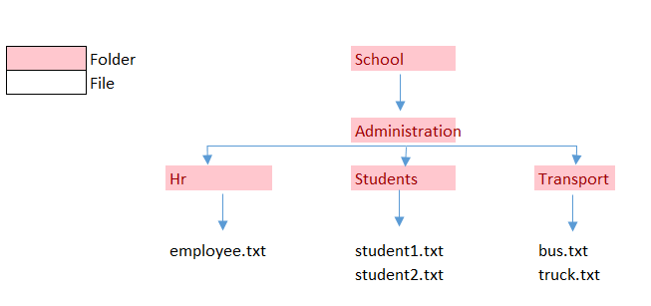
Lab:
1. Display all files and directory
2. Display name of current shell
3. Display name of current working directory
4. Display today's date
5. Display calendar of year
6. Display home directory
7. Create file structure
Add some content to student1.txt using vi editor
Create a file teacher.txt in Students folder and add some content to it.
Copy the teacher.txt from Students foler to Hr
Create a file admin.txt in Hr folder and move it to Transport folder
Move to control from transport folder to Administrator folder.
Move to home directory
Give read, write and execute access to file student.txt
Display all hidden files.
List all files found in the current directory and its hierarchy
$ find.
List all files found in the current hierarchy, and all the hierarchy below /school/Administration
find. /school/Administration

Slide 23
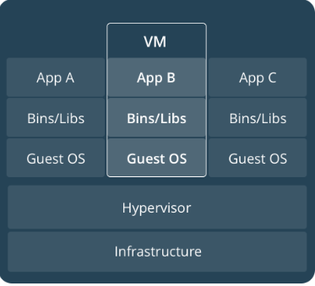
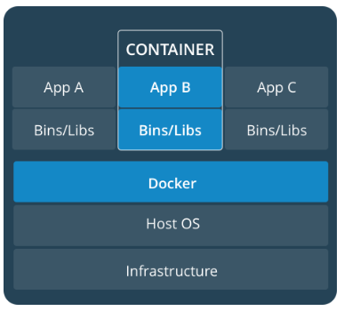
Containerization and VM

Slide 24
Cloud Computing Overview
Cloud computing is the on-demand delivery of IT resources over the Internet with pay-as-you-go pricing.
Instead of buying, owning, and maintaining physical data centers and servers, you can access technology services, such as computing power, storage, and databases, on an as-needed basis from a cloud provider

Slide 25
Why Cloud Computing?
Cloud computing is providing developers and IT departments with the ability to focus on what matters most and avoid undifferentiated work like procurement, maintenance, and capacity planning.
As cloud computing has grown in popularity, several different models and deployment strategies have emerged to help meet specific needs of different users.
Each type of cloud service, and deployment method, provides you with different levels of control, flexibility, and management.

Slide 26
Types of Computing Models
 | IaaS | Paas | SaaS
What it is? | Cloud-based services, pay-as-you-go for services such as storage, networking, and virtualization. | Hardware and software tools available over the internet. | Software that’s available via a third-party over the internet.
Eg: | AWS EC2, Rackspace, Google Compute Engine (GCE), Digital Ocean, | AWS Elastic Beanstalk, Heroku, Windows Azure, Force.com, OpenShift, | Google Apps, Salesforce, Dropbox, Slack,
Advantages | With IaaS, you can buy what you need, as you need it, and purchase more as your business grows. It puts control over the infrastructure back in your hands | A PaaS solution provides the platform for developers to create unique, customizable software. | You no longer need to engage an IT specialist to download the software onto multiple computers throughout your office or worry about keeping the software on every computer up-to-date.
When to use? | beneficial to businesses of all shapes and sizes, as it allows complete control over your infrastructure, and operates on a pay-as-you-use model, so it fits into most budgets. | PaaS is often the most cost-effective and time-effective way for a developer to create a unique application. PaaS allows the developer to focus on the creative side of app development, as opposed to menial tasks such as managing software updates or security patches. All of their time and brainpower will go into creating, testing, and deploying the app. | SaaS platforms are ideal for when you want an application to run smoothly and reliably with minimal input from you.
Summary | To provide you with maximum flexibility when it comes to hosting custom-built apps, as well as a providing a general data center for data storage. | Most often built on top of an IaaS platform to reduce the need for system administration. It allows you to focus on app development instead of infrastructure management. | Offers ready-to-use, out-of-the-box solutions that meet a particular business need (such as website or email). Most modern SaaS platforms are built on IaaS or PaaS platforms.

Slide 27
Benefits of cloud computing
Agility
Quick spin up of resources in minutes (storage, DB, IoT etc)
Elasticity
Don’t have to over-provision resources up front to handle peak levels of business activity in the future.
Cost Saving
The cloud allows you to trade capital expenses (such as data centers and physical servers) for variable expenses, and only pay for IT as you consume it. Plus, the variable expenses are much lower than what you would pay to do it yourself because of the economies of scale.
Deploy globally in minute

Slide 28



Cloud Computing Deployment Model
Cloud
Hybrid
On-Premises

Slide 29
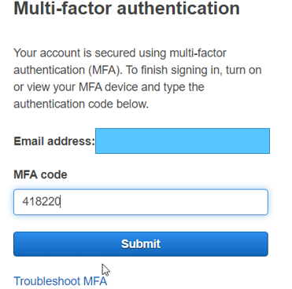
What is AWS?
Amazon web service is a platform that offers flexible, reliable, scalable, easy-to-use and cost-effective cloud computing solutions.
Log on to AWS account
Root User
IAM User

Slide 30
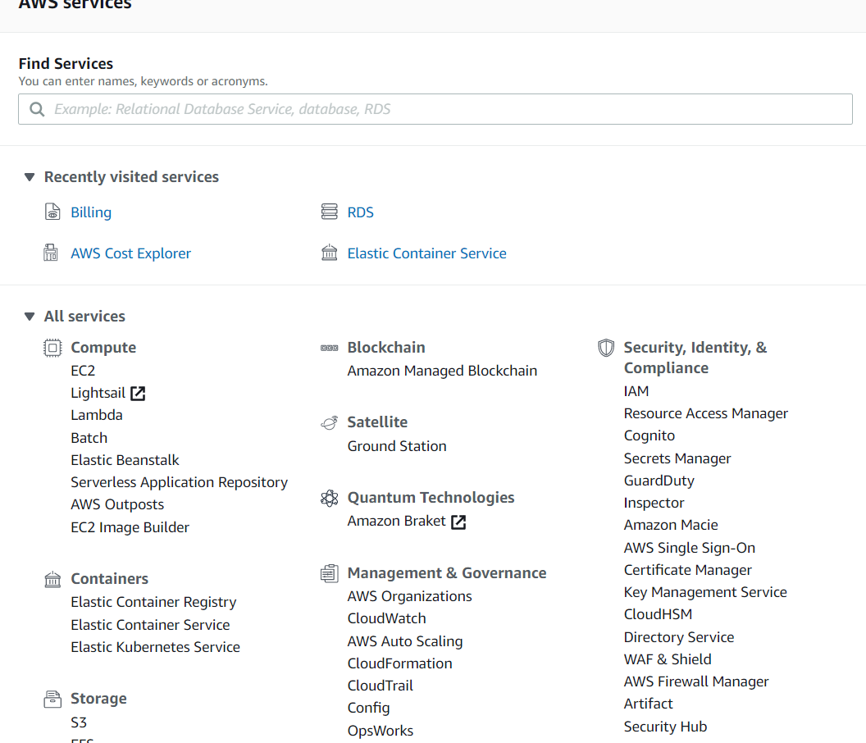
AWS Services

Slide 31
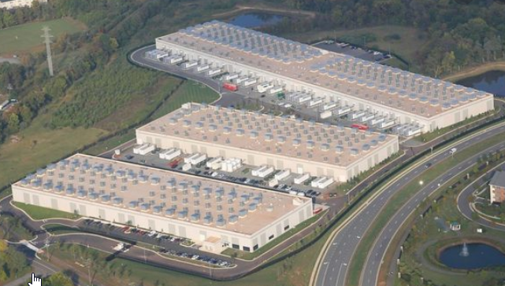
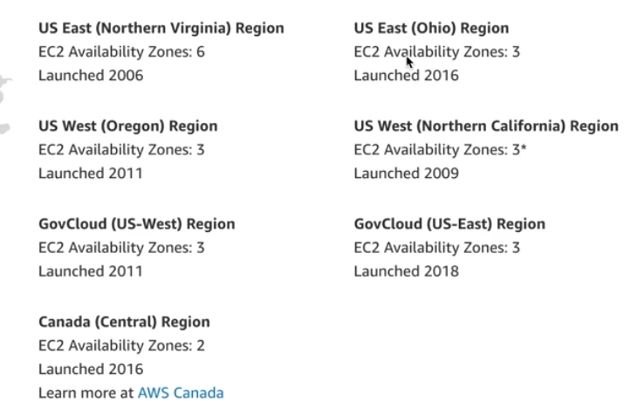
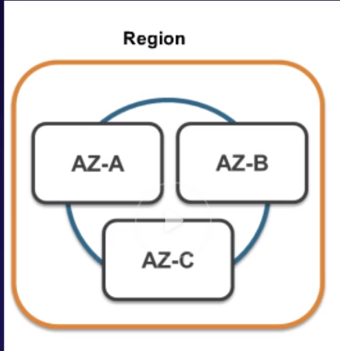
AWS Global Infra Structure
Availability Zone
Data Center is building filled with Servers.
One or more discrete data centers , each with redundant power, networking and connectivity , housing in separate facilities.
Region
– Region is physical location in world consist of two or more availability Zones.
https://aws.amazon.com/about-aws/global-infrastructure/regions_az/#:~:text=all%20AWS%20locations-,Regions,AZ's%20within%20a%20geographic%20area.

Slide 32
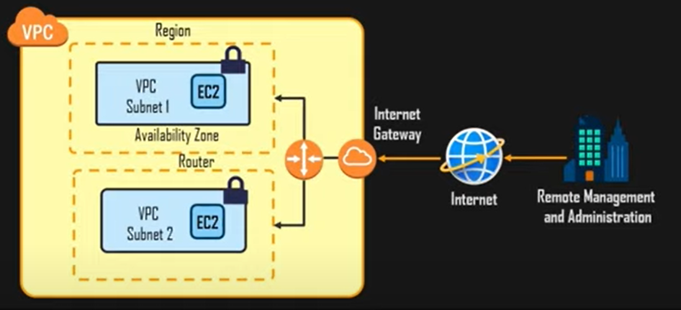
Virtual Private Cloud
It is space where you can provide own network.
It enables you to launch AWS resources into virtual network that you have defined.
This closely resembles the traditional network that you operate in your own data center with benefits of using scalable infrastructure of AWS.

Slide 33
Why VPC?
Moving to cloud
Major factors to be considered are
Privacy
Security
Preventing loss of propriety of data

Slide 34
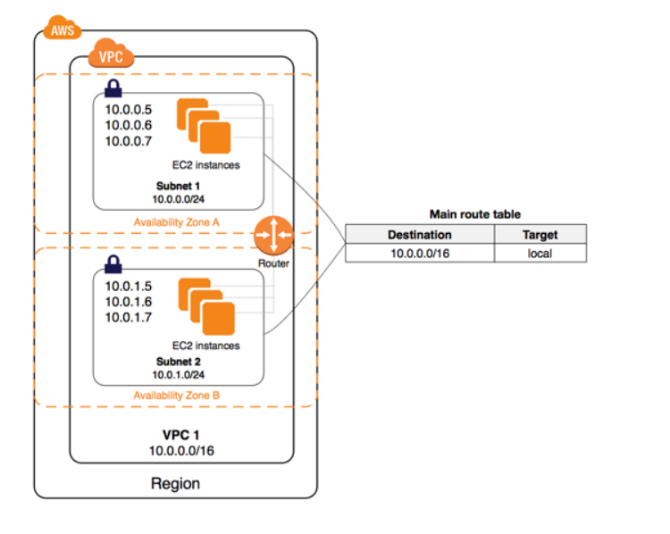
AWS VPC
https://docs.aws.amazon.com/AWSEC2/latest/UserGuide/EC2_GetStarted.html

Slide 35
Create an AWS Account
https://aws.amazon.com/premiumsupport/knowledge-center/create-and-activate-aws-account/

Slide 36
IAM Service
Identity Access Management

Slide 37
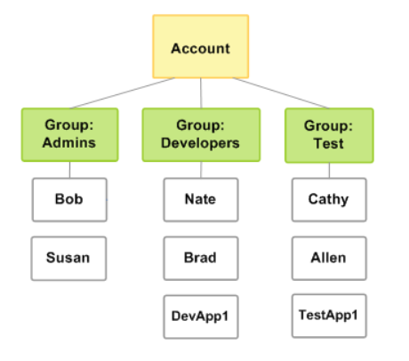
AWS IAM
AWS Identity and Access Management (IAM) is a web service that helps you securely control access to Amazon resources. You use IAM to control who is authenticated (signed in) and authorized (has permissions) to use resources.
https://docs.amazonaws.cn/en_us/IAM/latest/UserGuide/getting-started.html

Slide 38
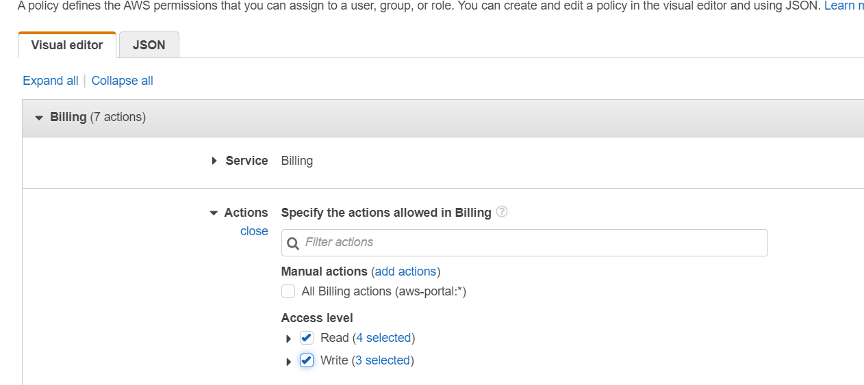
AWS Users
Add a Users
Set Programmatic Access
AWS Management Console

Slide 39
AWS EC2
An EC2 instance is nothing but a virtual server in Amazon Web services terminology.
Amazon Elastic Compute Cloud (Amazon EC2) is a web service that provides secure, resizable compute capacity in the cloud.
Allows you to obtain and configure capacity with minimal friction.

Slide 40
EC2 Configuration
AMI
AMIs - Preconfigured templates for your instances, known as Amazon Machine Images (AMIs).
Instance Type
CPU , Storage and network capacity
Instance details
Network, IP assignment, subnet,
Storage
Volume
Tag
This gives visibility to the AWS account administrator when there are lot number of instances.
Security Group
A security group acts as a virtual firewall for your EC2 instances to control incoming and outgoing traffic. Inbound rules control the incoming traffic to your instance, and outbound rules control the outgoing traffic from your instance.

Slide 41
On Demand
Low cost and flexible EC2 without upfront payment or long term commitment.
Short term , Spiky or unpredictable workloads that cannot be interrupted.

Slide 42
Steps to Create EC2
Step 1: Choose AMI
Step 2: Choose Instance Type
Step 3: Configure Instance
Step 4: Add Storage
Step 5: Add Tags
Step 6: Add Security
Step 7: Launch
Step 8: Connect
https://docs.aws.amazon.com/AWSEC2/latest/UserGuide/EC2_GetStarted.html

Slide 43
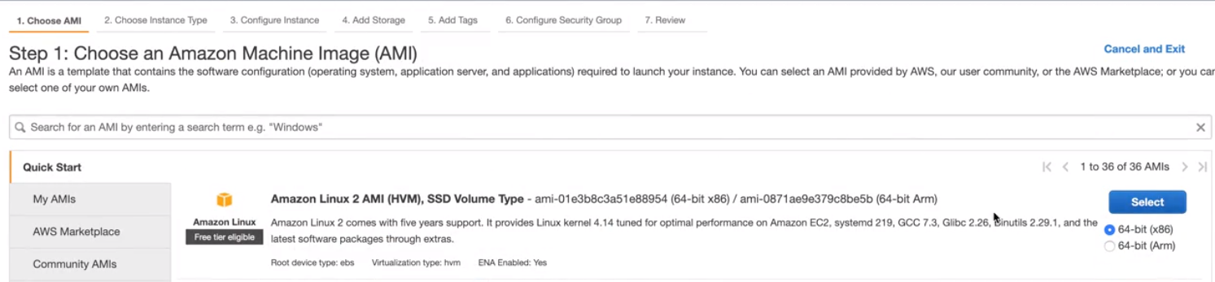
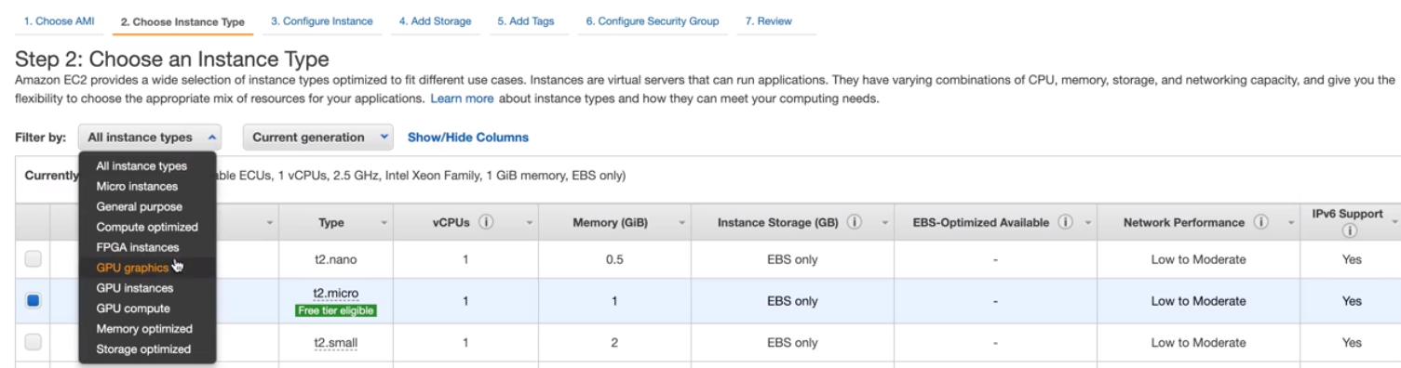
EC2 – Step 1 -2

Slide 44
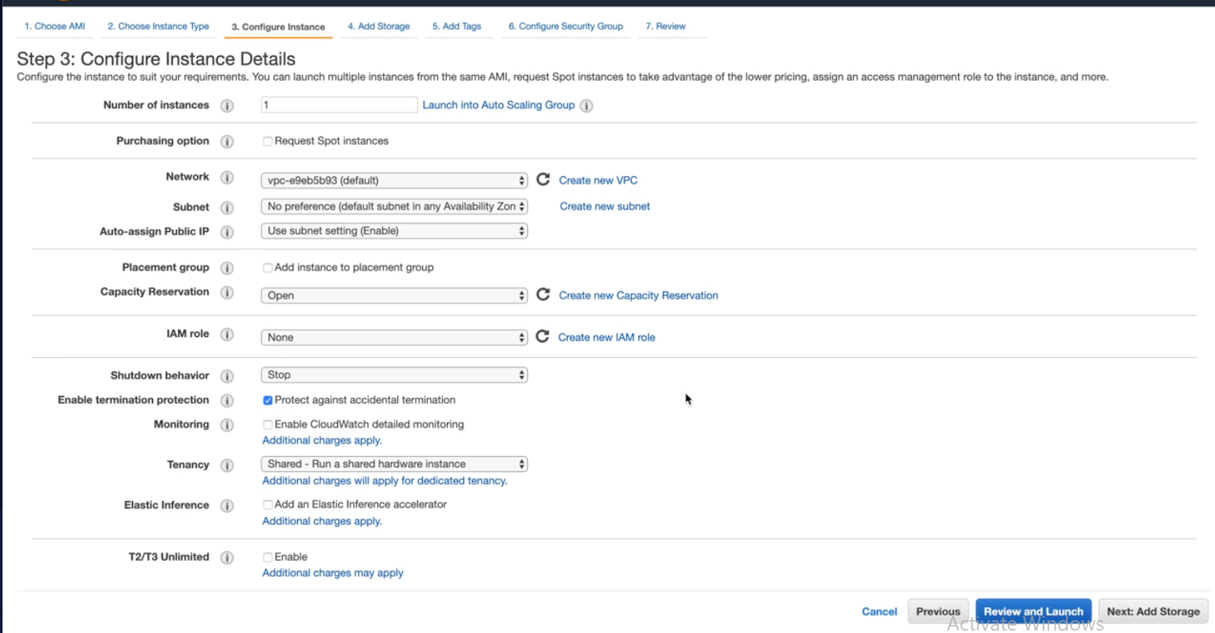
Ec2- Step 3

Slide 45
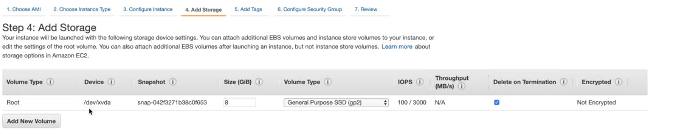
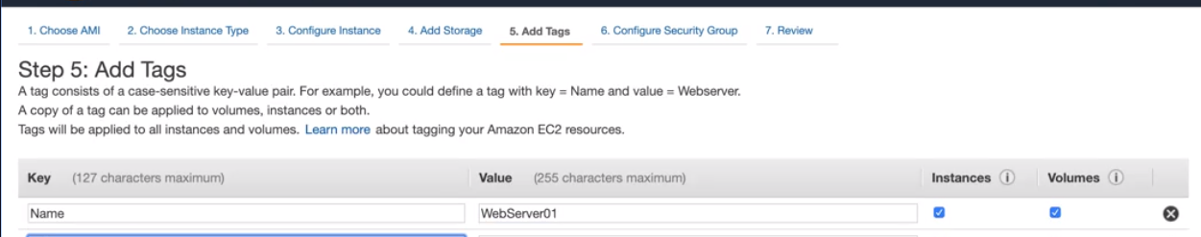
Ec2- Step 4

Slide 46
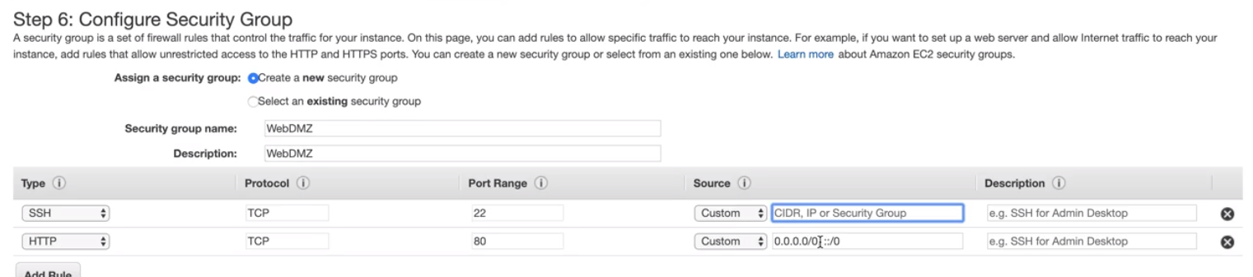
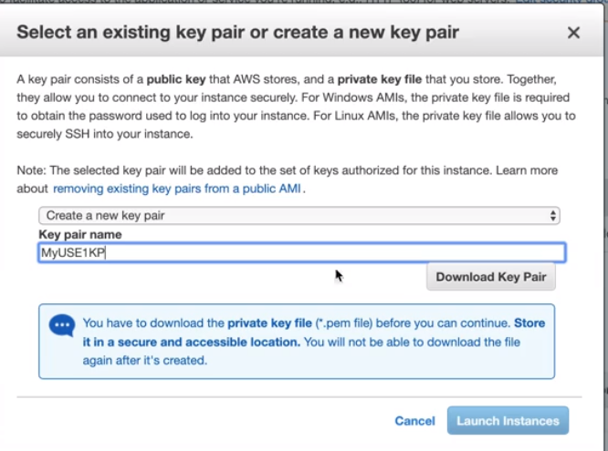
Ec2 - Step 6

Slide 47
Connect to EC2 instance
Without SSH
With SSH

Slide 48
What is SSH?
SSH is a network protocol that allows 2 machines to communicate securely over network.
Securely connect to a machine over unsecure network
Data travels in plain text over the network even login and password also.
It allows data to travel over a tunnel to
Securely login into machine
Securely transmit files
Safely issue remote commands

Slide 49
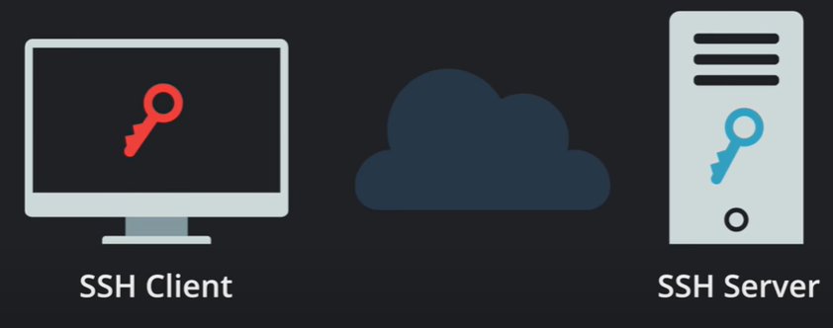

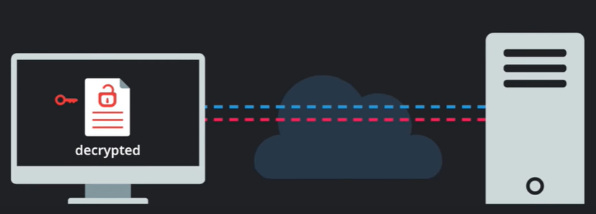

How does it work?
SSH client holds a private it and Server holds a public key
SSH client sends a private key id to server.
Server send a challenge to decrypt a public key.
It decrypted by private key and finally a secure connection
is established.

Slide 50
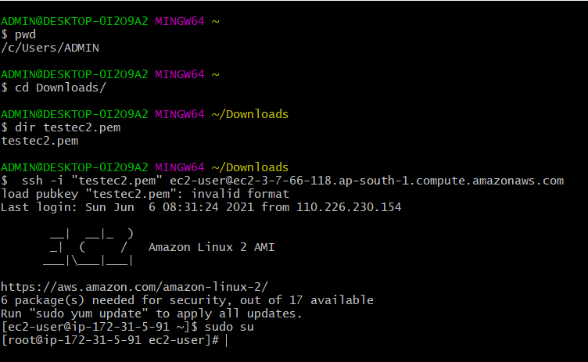
SSH connection using GitBash

Slide 51
Setup a WebServer to display web page on EC2
Step 1: Become the root user. command: sudo su
Step 2: Update Kernal command: yum update -y
Step 3: Install Apache command: yum install httpd -y
Step 4: Start Apache command: service httpd start
Step 5: Check Status of Service command: service httpd status
Step 6: in /var/www/html folder : echo "<html><h1>Hello AWS</h1></HTML>" > index.html
Step 7: Test in browser with IP address using public ip address: http://<public ip address on ec2>

Slide 52
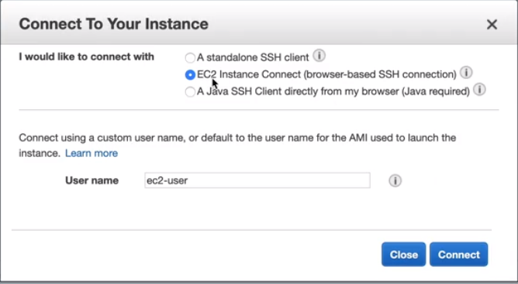
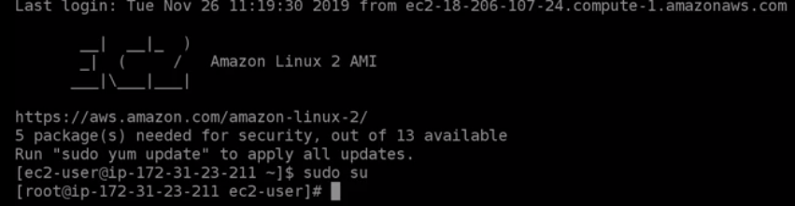
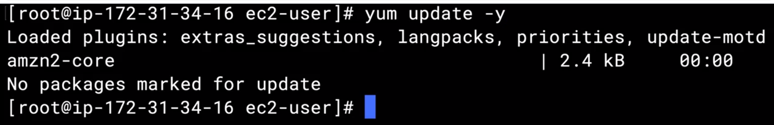
Launch Without ssh
Description - Public IP is 54.162.133.164
Update OS
Install Apache server

Slide 53
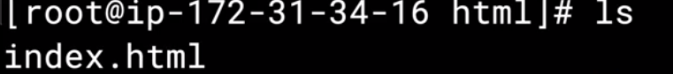
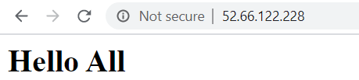
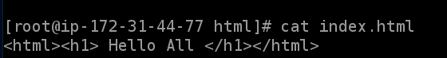
Create Index file and run on browser
Switch to /var/www/html folder
52.66.122.228
Verify the Ec2 if EC2 is accidently reboots using chkconfig

Slide 54
Security Groups

Slide 55
Security Group
A security group acts as a virtual firewall that controls the traffic for one or more instances.
When you launch an instance, you can specify one or more security groups; otherwise, we use the default security group.
You can add rules to each security group that allow traffic to or from its associated instances.
You can modify the rules for a security group at any time; the new rules are automatically applied to all instances that are associated with the security group.
When we decide whether to allow traffic to reach an instance, we evaluate all the rules from all the security groups that are associated with the instance.
INBOUND Rule
OUTBOUND Rule

Slide 56
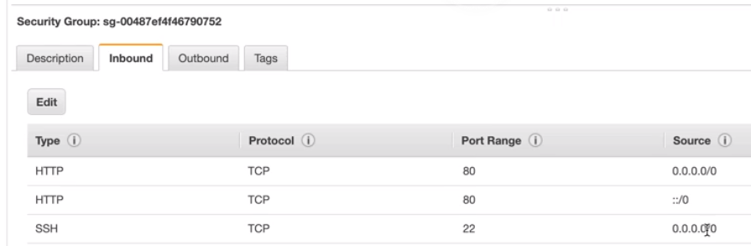
Characteristics
By default, security groups allow all outbound traffic.
Security group rules are always permissive; you can't create rules that deny access.
You can add and remove rules at any time
Inbound rules
Protocol type | Port number | Source IP
TCP | 22 (SSH) | 203.0.113.1/32 | TCP Traffic on port 22 (SSH) to and from the instance is tracked, because the inbound rule allows traffic from 203.0.113.1/32 only, and not all IP addresses (0.0.0.0/0).
TCP | 80 (HTTP) | 0.0.0.0/0 | TCP traffic on port 80 (HTTP) to and from the instance is not tracked, because both the inbound and outbound rules allow all traffic (0.0.0.0/0).
ICMP | All | 0.0.0.0/0 | ICMP traffic is always tracked, regardless of rules.
Outbound rules
Protocol type | Port number | Destination IP
All | All | 0.0.0.0/0 | If you remove the outbound rule from the security group, then all traffic to and from the instance is tracked, including traffic on port 80 (HTTP).

Slide 57
AWS EBS (Elastic Block Store)
EBS is disk volume that you attach to EC2.
Amazon Elastic Block Store (Amazon EBS) provides block level storage volumes for use with EC2 instances. EBS volumes behave like raw, unformatted block devices. You can mount these volumes as devices on your instances.
$lsblk
https://docs.aws.amazon.com/AWSEC2/latest/UserGuide/ebs-using-volumes.html

Slide 58
Package Management
Package management is a method of installing, updating, removing, and keeping track of software updates from specific repositories (repos) in the Linux system.
Just one command can be used to do automatically.
Eg:
YUM
$ yum install httpd –y ( If you want to install packages automatically without asking any confirmation, use option -y)
$ yum update –y
$ yum -y remove httpd
$ yum list | less

Slide 59
S3

Slide 60
What is S3
Amazon Simple Storage Service (Amazon S3) is storage for the Internet. It is designed to make web-scale computing easier.
Amazon S3 has a simple web services interface that you can use to store and retrieve any amount of data, at any time, from anywhere on the web. It gives any developer access to the same highly scalable, reliable, fast, inexpensive data storage infrastructure that Amazon uses to run its own global network of web sites. The service aims to maximize benefits of scale and to pass those benefits on to developer.

Slide 61
Unix
Operating System

Slide 62
Operating System
To control and manage computer hardware, software resources, and Operating system is required for the computer. The operating system acts as the intermediate between hardware and the user-defined application software.

Slide 63
Unix Architecture
Kernal
Computer hardware such as memory, disc, printers, etc.. are controlled by the kernel.
The kernel schedules the processes, control and executes various user-defined tasks.
Manages the data storage and control the computer accesses by several users.
The kernel is composed of several sub-components such as configurations including boot code, device drivers to control hardware, header files.
Shell
It is the interface between the user and the kernel.
Users can interact with the shell using shell commands.
Shell has two main responsibilities which include interpreting the commands given by the users and execute them using the kernel, providing programming ability to the users to write shell commands for a shell script to perform specific tasks.
Eg: Bourne shell , Bash, C

Slide 64
Unix Architecture
System Calls:
A system call is a way for programs to interact with the operating system. A computer program makes a system call when it makes a request to the operating system’s kernel.
System call provides the services of the operating system to the user programs via Application Program Interface(API)
FileManagement/ Device Management

Slide 65
Unix File System
Unix File System can be defined as a framework that organizes and stores a huge volume of data that can be handled with ease. It involves elements like file which is a collection of related data that can be viewed logically, appears as a stream of bytes, with attributes containing information in relation to the concerned file.
The file system consisting of two main
files
Directories
The entire system following a hierarchy in which directories act as special files that contain multiple files with the highest-level directory in the entire hierarchical structure being termed as root which is symbolically denoted by ‘/’. There can be many subdirectories under this directory.

Slide 66
Unix FileSystem
bin: It is a short form for binary files. This directory stores the commonly used executable commands.
mnt: This contains information regarding the mounted devices.
root: This is the root user’s home directory.
tmp: This is a storage for temporary files. As they are temporary they are removed periodically from the filesystem.
usr: It contains a set of executable commands
home: It has a collection of directories and files.
proc: It contains files that are related to system processes.

Slide 67
File Permssion

Slide 68
Lab: FilePermission
chmod u+x student.txt
chmod u-x student.txt
$ chmod 777 file1
$ ls –l
https://en.wikipedia.org/wiki/Chmod

Slide 69
Types of File System
1. Ordinary Files
These files are used to store information of the users. It may be some text or any image which is stored. It is normally located under a directory and does not contain any other files.
2. Directories
Directories help in organizing the files which are present. The directories can contain ordinary files, special files or even other directories. All these directories are the descendants of the root directory.
3. Special Files
The special files are used to represent physical devices like printer, tape driver or a terminal. Unix considers any device to be a file. Even the terminal is considered to be a file.

Slide 70
Unix
Pwd
Present working directory
Cd /
Switch to root /
Cd ~
Switch to home directory
Cd /home
Switch to home folder in
Cd ..
Switch to a folder back in file structure.
Mkdir <fodlername>
Create a folder
Touch student.txt
Create an empty filer
Date
Display current date
Cal
Ps
Whoami - Print current login user.
Who - List all login users.
Ps
echo "$SHELL"

Slide 71
Unix Commands
Three types of files
Ordinary File
Directeries
Special files
Commands
Ls
Ls –l
First Column − Represents the file type and the permission given on the file. Below is the description of all type of files.
Second Column − Represents the number of memory blocks taken by the file or directory.
Third Column − Represents the owner of the file. This is the Unix user who created this file.
Fourth Column − Represents the group of the owner. Every Unix user will have an associated group.
Fifth Column − Represents the file size in bytes.
Sixth Column − Represents the date and the time when this file was created or modified for the last time.
Seventh Column − Represents the file or the directory name.
find "a.txt"
ls -l | grep "student“
Env
$ ps // Print processes of current user
$ ps -e // Print all processes
$ ps -ef // Print all processes in full-listing

Slide 72
Cut Command
The cut command extracts a given number of characters or columns from a file. For cutting a certain number of columns it is important to specify the delimiter. A delimiter specifies how the columns are separated in a text file
Lab :Create a file emp.txt
$ echo "Employee_id;Employee_name;Department_name;Salary
10001;Employee1;Electrical;20000
10002; Employee2; Mechanical;30000
10003;Employee3;Electrical;25000
10004; Employee4; Civil;40000" > emp.txt

Slide 73
Cut Command
Extract 5 column
$ cut -c 5 data.txt
Extract
$ cut -c 5-7 emp.txt

Slide 74
Unix – File Permission
Owner permissions − The owner's permissions determine what actions the owner of the file can perform on the file.
Group permissions − The group's permissions determine what actions a user, who is a member of the group that a file belongs to, can perform on the file.
Other (world) permissions − The permissions for others indicate what action all other users can perform on the file. Owner permissions − The owner's permissions determine what actions the owner of the file can perform on the file.
Group permissions − The group's permissions determine what actions a user, who is a member of the group that a file belongs to, can perform on the file.

Slide 75
Special System's Environment Variables
HOME: contains your home directory.
PATH: contains the list of search paths for executing programs (defined in /etc/profile).
PWD: Full path of current working directory (OLDPWD for the previous working directory).
USER: Current login username.
SHELL: Current shell, e.g., /bin/bash
Set Path Permanently
export PATH=~/bin:/usr/local/mysql/bin:$PATH
echo "$USER"

Slide 76
Unix
Vi student.txt
i - Insert at cursor (goes into insert mode)
:wq – Save file
A – Write after cursor (goes into insert mode)
A – Write at the end of line (goes into insert mode)
Dd – Delete line
ESC – Terminate insert mode
u – Undo last change
U – Undo all changes to the entire line
O – Open a new line (goes into insert mode)
3dd – Delete 3 lines.
D – Delete contents of line after the cursor
---------------------Moving in file-------------------
k - Move cursor up
j - Move cursor down
h - Move cursor left
l - Move cursor right
---------------Save file
:w - Save the file but keep it open
:q - Quit without saving
:wq - Save the file and quit

Slide 77
Lab:
1. Display all files and directory
2. Display name of current shell
3. Display name of current working directory
4. Display today's date
5. Display calendar of year
6. Display home directory
7. Create file structure
Add some content to student1.txt using vi editor
Create a file teacher.txt in Students folder and add some content to it.
Copy the teacher.txt from Students foler to Hr
Create a file admin.txt in Hr folder and move it to Transport folder
Move to control from transport folder to Administrator folder.
Move to home directory
Give read, write and execute access to file student.txt
Display all hidden files.
List all files found in the current directory and its hierarchy
$ find.
List all files found in the current hierarchy, and all the hierarchy below /school/Administration
find. /school/Administration

Slide 79
Containerization and VM

